Slide 1
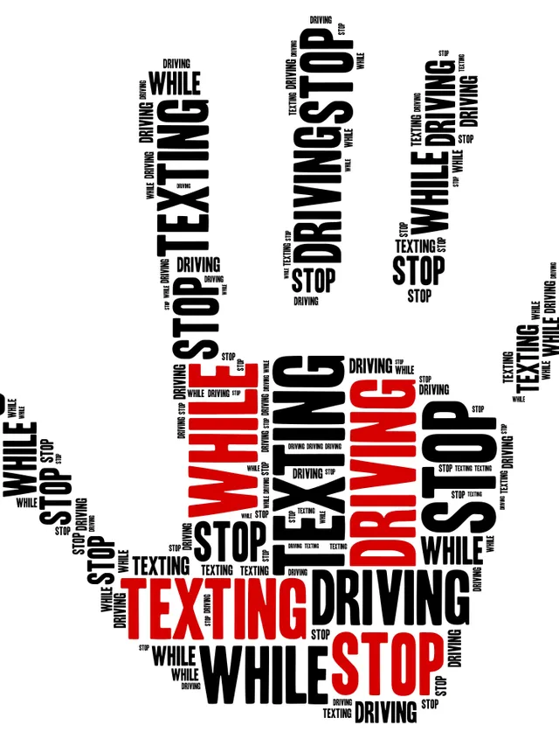
Detecting Texting while Driving
Kristina Robinson
Andrew Knaack
Sara Mace
Lucas Golinghorst
Derek Clayton
Ryan Baker

Slide 2
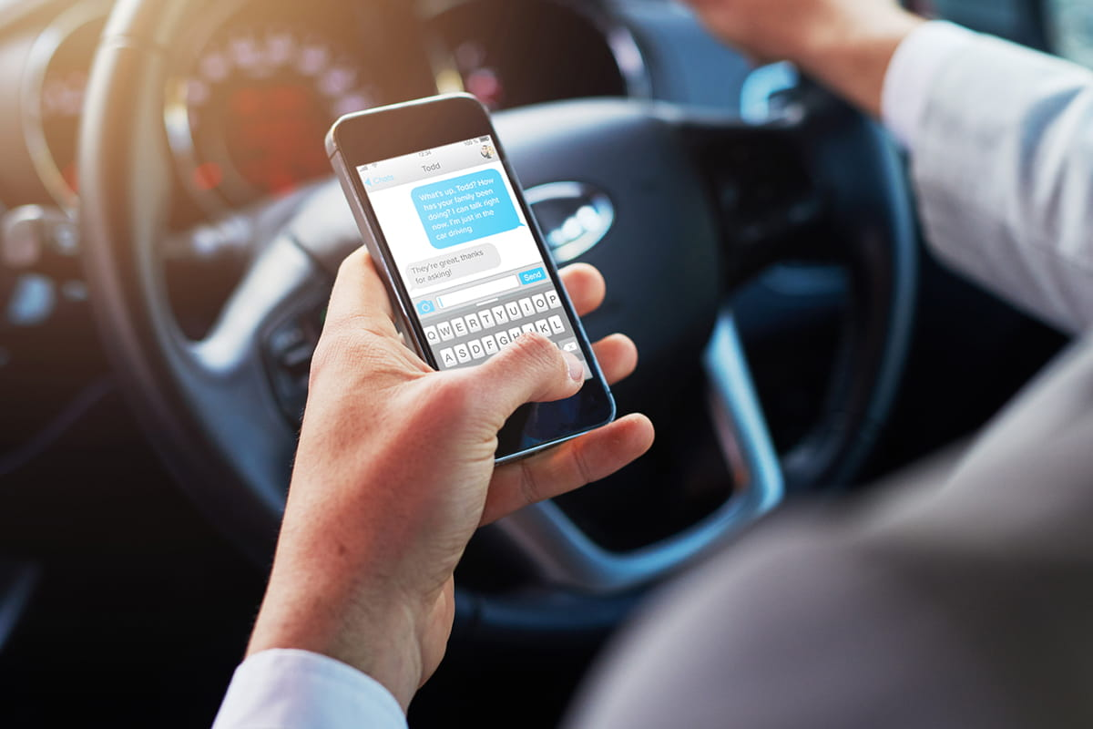
Problem Statement
Addresses the issue of texting while driving.
3 years ago, 391,000 injuries were caused by distracted driving accidents.
Our solution is to build an android application to detect if someone is texting while driving.
Our goals include detecting whether someone is in the driver’s seat.
In order to do that without simply locking out everyone from their phones, our solution will have to include many different measures to ensure accurate detection.
Notes:
Our project is aimed at directing the issue of texting while driving.
A study done 3 years ago, found out that 391,000 injuries are caused by distracted driving accidents
According to “100 distracted driving facts and statistics for 2018”, by TeenSafe, 9 people are killed every day from distracted driving accidents.
Sending a text might seem harmless but it takes the drivers eyes off the road for a few seconds at a minimum. TeenSafe states that it only takes 3 seconds of the driver not having their eyes on the road to be in a car crash
Our group has decided to build an android application that will detect if someone is sitting in the driver's seat and if they are texting.
We want to ensure that a passenger is still able to text we plan to have many different modules to ensure accurate detection.

Slide 3
2. Functional / Non-Functional Requirements
Functional
Prevent users from texting if they are driving
Error rate <= 10% , including false positive/negatives
Android OS 6.0 and newer.
Does not require Internet
Non-Functional
Easy to use
Does not crash at least 95% of the time
Comply with applicable sensitive data laws

Slide 4
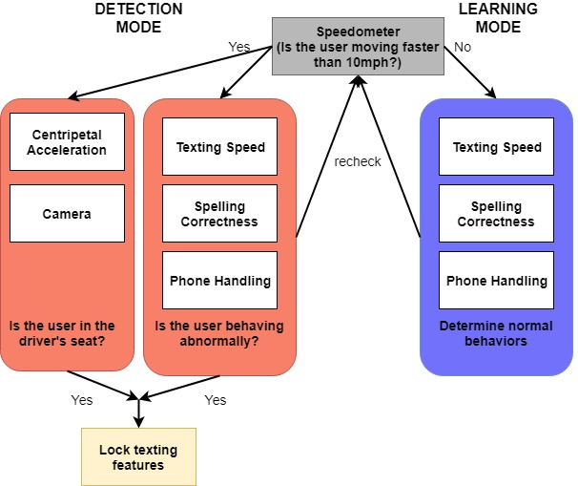
3. System Design (planned)

Slide 5
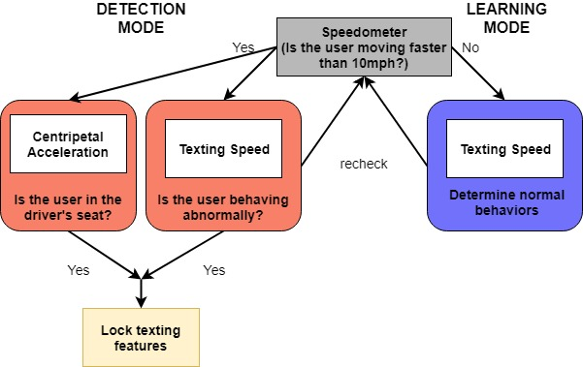
3. System Design (implemented)

Slide 6
4. System Implementation
Proprietary Texting Application
Speedometer
Texting Speed
Centripetal Acceleration
Spelling Correctness (Failed)
Phone Handling (Failed)
Camera Recognition (Failed)

Slide 7
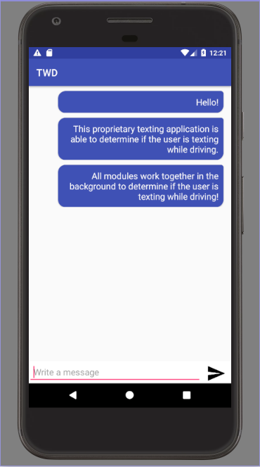
Proprietary Texting Application
Was built because we couldn’t use the built in text messaging application
Application allows user to type and send messages which works with modules to determine texting while driving

Slide 8
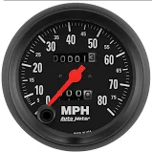
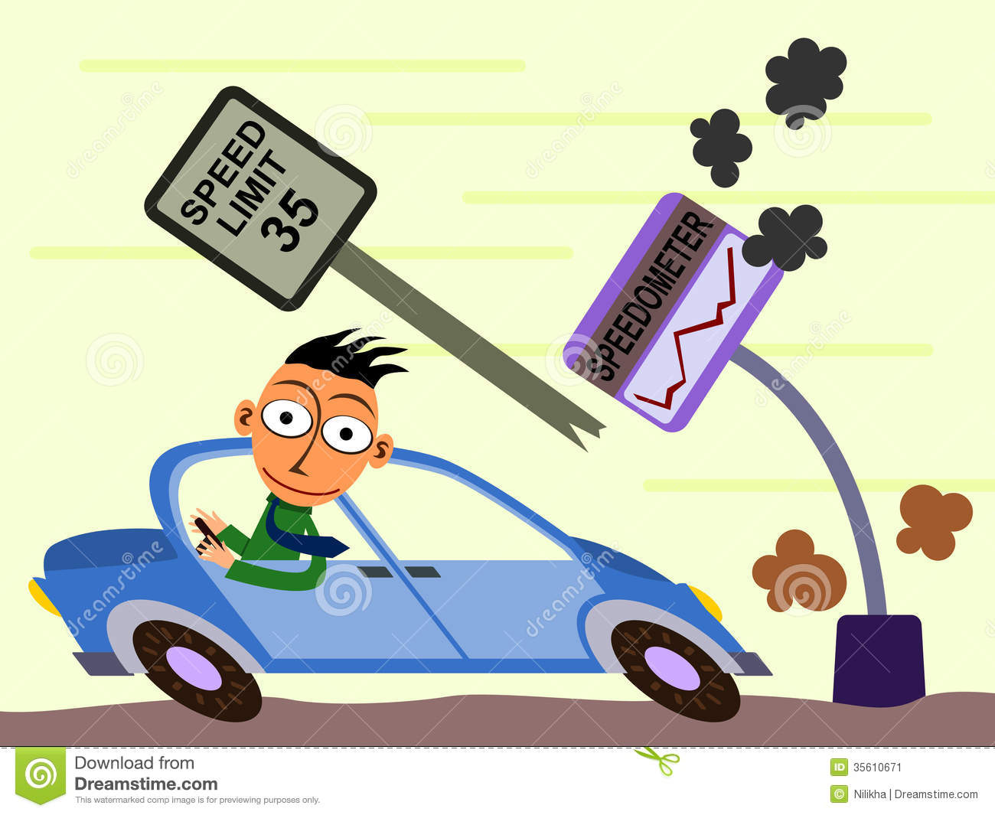
Speedometer
Location Services API
Uses GPS and (if possible) Wi-Fi signals
Updates every ~10 seconds
Provides getSpeed() method for main activity
Target danger speed is above 10 mph

Slide 9
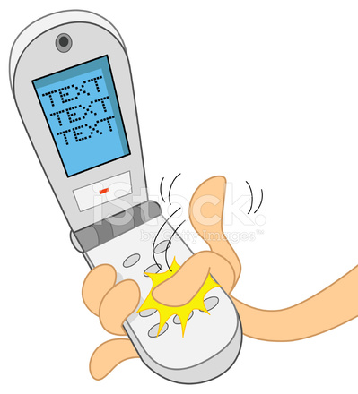
Texting Speed
Text Watcher API
Learning Mode: continuously update user’s average texting speed
Detection Mode: compare to known average

Slide 10
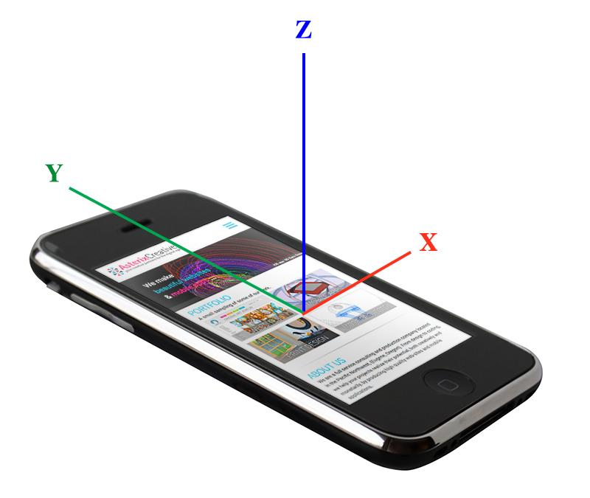
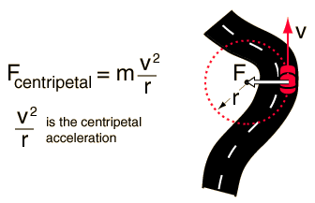
Centripetal Acceleration
Driver’s and passenger's experience different levels of centripetal acceleration during turns.
Using the gyroscope and magnetometer, it is possible to determine if the user is on the driver’s side or the passenger’s side.
Module detects turns using the gyroscope.
Turn amplitude calculated using magnetometer readings.
Notes:
The centripetal acceleration module uses the phone sensors to detect whether the user is on the driver side or passenger side.
The driver and passenger sides experience different amounts of centripetal acceleration during turns.
It employs two sensors, the gyroscope and magnetometer.
The gyroscope measures rotational motion and detects if the vehicle is turning.
The magnetometer detects the orientation of the phone relative to Earth’s magnetic north.
By taking the difference between the magnetometer readings at the start and end of a turn, we can get the amplitude of the turn and use it in the centripetal acceleration calculation.
Once the amplitude of a turn is known, the module will then detect which side the user is on. For example, during a left turn, the driver experiences more centripetal acceleration and will have a smaller amplitude than the passenger.
This module, like all the others, required modular testing to work out all the quirks . . .

Slide 11
Spelling Correctness
Has built-in Android API Spell Checker Session
Unfortunately, has been disabled on some phones for a few years now
NOT VIABLE

Slide 12
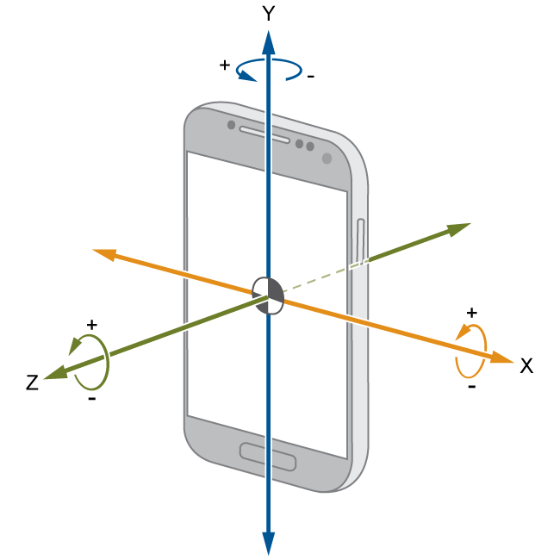
Phone Handling
Gyroscope and Magnetometer were evaluated to look at differences in how the user holds their phone
Both sensors did not give a large enough difference to determine differences in normal phone behavior and texting behaviors
Not a viable module

Slide 13
Camera Recognition
Open-source libraries for training machine learning algorithms dedicated to image recognition
Tensorflow- Did not work because...
Does not allow training of only one class
Requires several old programs
OpenCv - More precise processing power (using Bitmapping), but...
Less developed API tools, no built-in image classes.
Overall, required more data images of seatbelts (~10,000) to create a defined target image, and a software library that had training tools to build the seatbelt class.

Slide 14
5. Module Testing & Evaluation
Centripetal Acceleration
Made consecutive left turns or right turns in a parking lot
Recorded number of times driver and passenger were correctly identified
Turns are determined correctly 100% of the time
Identification of user location is correct 54% of the time
Speedometer
Printed out recorded speed and drove around with another person to compare recorded speed to actual speed
Test zones: Ames, Des Moines, I-35
Texting Speed
Played Mario Kart to simulate distracted driving
Typed predetermined messages to see if the user would be locked out after dropping below 70% of normal texting speed

Slide 15
5. Integration Testing & Evaluation
Each module was independently tested to make sure that they would block a user from texting if certain thresholds were met
Speedometer: if the speed reached 10 miles per hour or above the user would be blocked from texting
Texting Speed: if texting speed dropped below 70% of their average speed, the user would be blocked from texting
Centripetal Acceleration: If the user was identified as a driver, they were blocked from texting

Slide 16
5. System Testing & Evaluation
All modules were considered for blocking a user from texting if they met the appropriate thresholds
Tested by driving around a parking lot making left and right turns and imitated distracted behavior.
Reached our fourth milestone of false positive and false negative rates at or below 50%
False positive rate: 0%
False negative rate: 40%

Slide 17
6. Use-Case Scenarios
Speed > 10mph | User is Driver | Distracted Texting | Texting Lock
F | F | F | No
F | F | T | No
F | T | F | No
F | T | T | No
T | F | F | No
T | F | T | No
T | T | F | No
T | T | T | Yes

Slide 18
7. Conclusions
It is possible to determine if someone is texting while driving.
Future improvements:
Machine Learning
Use Texting Speed and Centripetal Acceleration
Take into account different phones and different users
Determine if the user is sitting in the back seat or the front seat
Currently only determines if in driver or passenger side of car

